Slide 1

Make uncertainty great again!
Notes:
I have wanted to give this presentation for quite some time, but due to other priorities I have not been able to do so! So I am sorry for being a bit rusty in some terminology, because I do not really work with this sort of problems on a day to day basis any more. This presentation was and is focused around my research for around 2.5 years ago, and a course I took in probabilistic machine learning, when I wanted to learn about uncertainties of our predictions made by our trained neural networks. I will not go into my research at that time, since I was focused on inverse problems in computational geophysics, which is not actually an intuitive domain to give these kinds of presentations. So the examples that I provide here are more toy examples from courses and learning material online. And of course, we can not jump over some of the fundamental understanding of probability theory and the mathematics behind it in order to pull you in to have sort of similar intuition of why/how/when we should/could integrate Bayesian learning into our problem space.
In these three figures you see here encapsulate some of the most important features of Baysian learning, where we want to estimate not only our best model fitted to the training data, but many different models, nest best, nest nest best and so on, which are sampled from the same model architecture. And for us to be able to do this, we need to estimate the probabilit distribution over our model parameters given the data that we observe!
Explain figures shortly.
So lets start diving into Bayesian thinking and the beautiful math that surrounds it!

Slide 2
Make uncertainty great again!
Why Bayesian learning - and thinking - is important
Uncertainty Quantification: In critical domains like healthcare or finance, uncertainty associated with predictions may be crucial for decision-making.
Robustness to Overfitting: Bayesian neural networks offer a natural regularization mechanism by placing priors over the network weights.
Handling Small Datasets: Bayesian neural networks can provide more robust predictions with limited data.
Model Flexibility: Uncertainty estimates provided by Bayesian methods can also help in model selection, allowing for more informed decisions about model architecture.
Notes:
- Uncertainty Quantification:
- Critical in domains like healthcare and finance for decision-making.
- Uncertainty associated with predictions can be crucial.
- Robustness to Overfitting:
- Bayesian neural networks offer natural regularization.
- Priors placed over network weights help prevent overfitting.
- Handling Small Datasets:
- Bayesian neural networks provide robust predictions with limited data.
- Useful in scenarios where data scarcity is a challenge.
- Model Flexibility:
- Bayesian methods offer uncertainty estimates.
- Aid in model selection and informed decisions on architecture.
- Helps in choosing the right model based on data and uncertainty.
These bullet points capture the key reasons why Bayesian learning and thinking are important, as mentioned in the content of your first slide. They can serve as a useful guideline for your presentation notes.

Slide 3
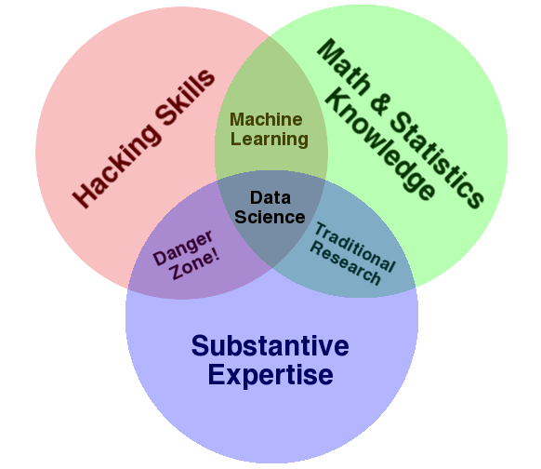

Make uncertainty great again!
Outline
- Fundamentals of Bayesian learning
- Motivating examples
- Do I have the disease?
- The deterministic doctor vs. the deterministic neural net
- Cat vs. Dog
- Notebook
- References and learning material
Data science
The data scientist
http://drewconway.com/zia/2013/3/26/the-data-science-venn-diagram

Slide 4

Make uncertainty great again!
Outline
- Fundamentals of Bayesian learning
- Motivating examples
- Do I have the disease?
- The deterministic doctor vs. the deterministic neural net
- Cat vs. Dog
- Notebook
- References and learning material
Data science
The data scientist
👎
http://drewconway.com/zia/2013/3/26/the-data-science-venn-diagram

Slide 5

Make uncertainty great again!
Outline
- Fundamentals of Bayesian learning
- Motivating examples
- Do I have the disease?
- The deterministic doctor vs. the deterministic neural net
- Cat vs. Dog
- Notebook
- References and learning material
Data science
The data scientist
👍
http://drewconway.com/zia/2013/3/26/the-data-science-venn-diagram

Slide 6
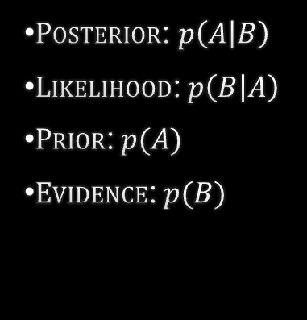

FUNDAMENTALs
Bayes theorem
$$p\left(A | B\right)=\frac{p\left(B | A\right)p(A)}{p(B)}$$
$Posterior$: $p\left(A | B\right)$
$Likelihood$:$p\left(B | A\right)$
$Prior$:$p(A)$
$Evidence$:$p(B)$
Notes:
- Bayes Theorem:
- Introduces a fundamental concept in Bayesian inference for updating beliefs based on evidence.
- Mathematically expresses how prior beliefs are combined with new evidence to calculate the revised probability of an event.
- Posterior Probability:
- Represents the updated probability of an event after considering new evidence.
- Explain how the posterior probability 𝑝(𝐴│𝐵) reflects the revised belief in event A given evidence B.
- Likelihood:
- Describes the likelihood of observing the evidence given the event of interest.
- Discuss how the likelihood 𝑝(𝐵│𝐴) informs the strength of the relationship between event A and evidence B.
- Prior Probability:
- Represents the initial belief in the event of interest before observing any evidence.
- Emphasize the role of the prior probability 𝑝(𝐴) in shaping the starting point for Bayesian inference.
- Evidence or Marginal Likelihood:
- Provides the overall probability of observing the available evidence.
- Highlight the significance of the evidence probability

Slide 7

FUNDAMENTALs
Bayes theorem
$$p\left(A | B\right)=\frac{p\left(B | A\right)p(A)}{p(B)}$$
$$p\left(spam | word\right)=\frac{p\left(word | spam\right)p(spam)}{p(word)}$$
$Posterior$: $p\left(A | B\right)$
$Likelihood$:$p\left(B | A\right)$
$Prior$:$p(A)$
$Evidence$:$p(B)$
Notes:
- Bayes Theorem:
- Introduces a fundamental concept in Bayesian inference for updating beliefs based on evidence.
- Mathematically expresses how prior beliefs are combined with new evidence to calculate the revised probability of an event.
- Posterior Probability:
- Represents the updated probability of an event after considering new evidence.
- Explain how the posterior probability 𝑝(𝐴│𝐵) reflects the revised belief in event A given evidence B.
- Likelihood:
- Describes the likelihood of observing the evidence given the event of interest.
- Discuss how the likelihood 𝑝(𝐵│𝐴) informs the strength of the relationship between event A and evidence B.
- Prior Probability:
- Represents the initial belief in the event of interest before observing any evidence.
- Emphasize the role of the prior probability 𝑝(𝐴) in shaping the starting point for Bayesian inference.
- Evidence or Marginal Likelihood:
- Provides the overall probability of observing the available evidence.
- Highlight the significance of the evidence probability

Slide 8

FUNDAMENTALs
Bayes theorem
$$p\left(A | B\right)=\frac{p\left(B | A\right)p(A)}{p(B)}$$
$$p\left(nerd | thomas\right)=\frac{p\left(thomas | nerd\right)p(nerd)}{p(thomas)}$$
$Posterior$: $p\left(A | B\right)$
$Likelihood$:$p\left(B | A\right)$
$Prior$:$p(A)$
$Evidence$:$p(B)$
Notes:
- Bayes Theorem:
- Introduces a fundamental concept in Bayesian inference for updating beliefs based on evidence.
- Mathematically expresses how prior beliefs are combined with new evidence to calculate the revised probability of an event.
- Posterior Probability:
- Represents the updated probability of an event after considering new evidence.
- Explain how the posterior probability 𝑝(𝐴│𝐵) reflects the revised belief in event A given evidence B.
- Likelihood:
- Describes the likelihood of observing the evidence given the event of interest.
- Discuss how the likelihood 𝑝(𝐵│𝐴) informs the strength of the relationship between event A and evidence B.
- Prior Probability:
- Represents the initial belief in the event of interest before observing any evidence.
- Emphasize the role of the prior probability 𝑝(𝐴) in shaping the starting point for Bayesian inference.
- Evidence or Marginal Likelihood:
- Provides the overall probability of observing the available evidence.
- Highlight the significance of the evidence probability

Slide 9
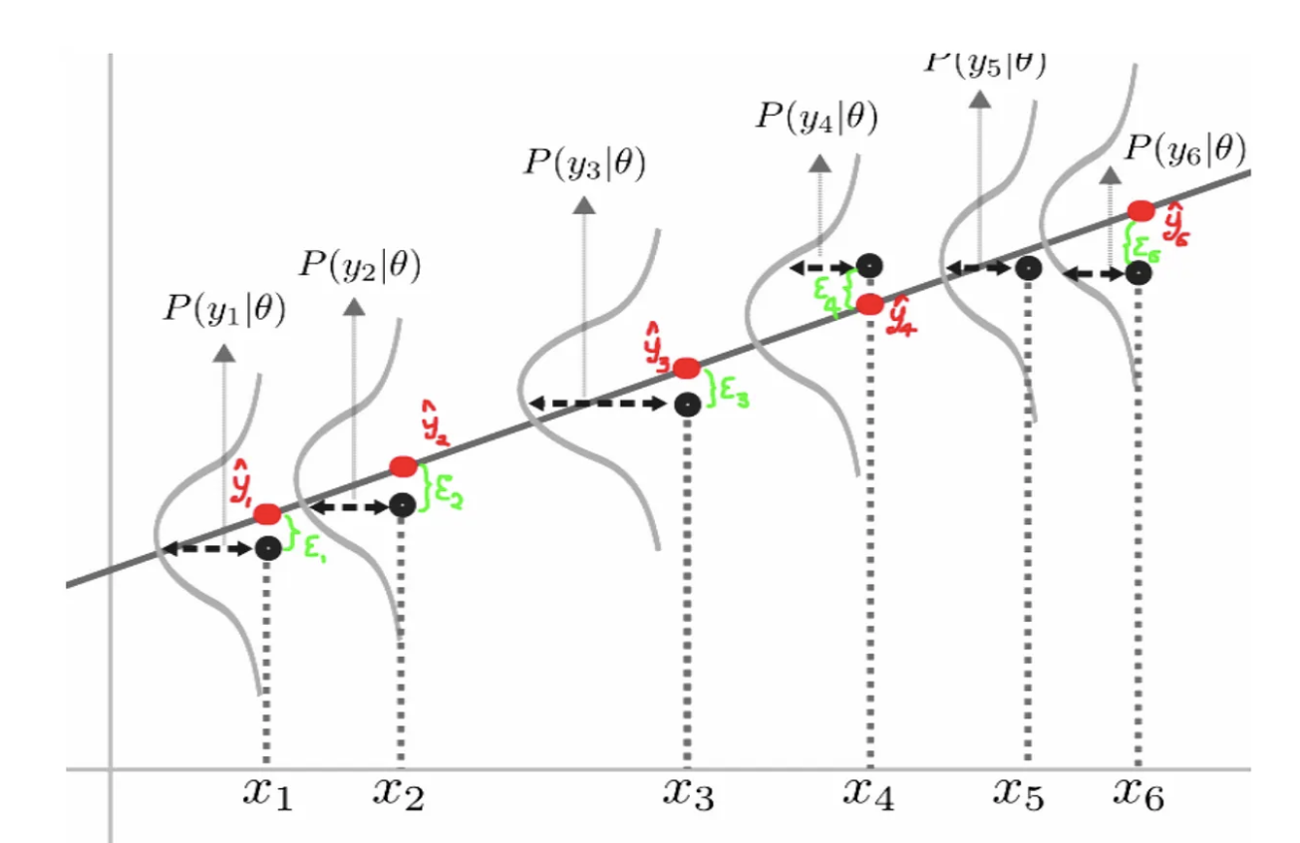
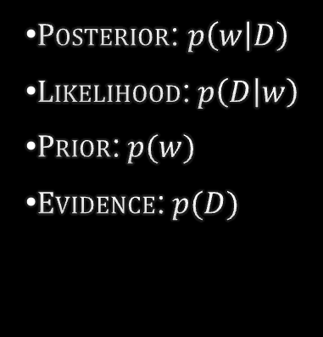
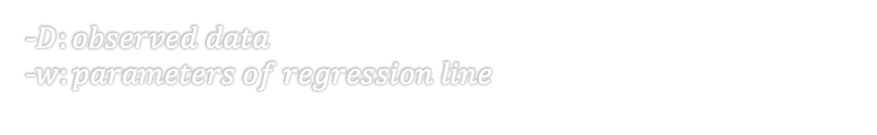


https://towardsdatascience.com/bayesian-thinking-estimating-posterior-distribution-for-linear-regression-data-ketchup-2f50a597eb06
FUNDAMENTALs
Bayes theorem
$$\hat{y}=f\left(x;w\right)$$
$$p\left(w | D\right)=\frac{p\left(D | w\right)p(w)}{p(D)}$$
-$D:observed data$
-$w:parameters of regression line$
$Posterior$: $p\left(w | D\right)$
$Likelihood$:$p\left(D | w\right)$
$Prior$:$p(w)$
$Evidence$:$p(D)$

Slide 10
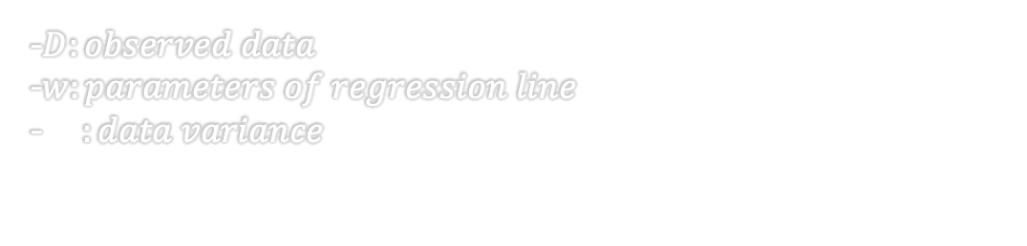


https://towardsdatascience.com/bayesian-thinking-estimating-posterior-distribution-for-linear-regression-data-ketchup-2f50a597eb06
FUNDAMENTALs
Bayes theorem
$$\hat{y}=f\left(x;w\right)$$
$$p\left(D | w\right)=\frac{1}{\sqrt{2πσ_{D}^{2} }}e^{−\frac{{\left(D−\hat{y}\right)}^{2}}{2σ_{D}^{2}}}$$
$$p\left(w | D\right)=\frac{p\left(D | w\right)p(w)}{p(D)}$$
-$D:observed data$
-$w:parameters of regression line$
-$σ_{D}^{2}:data variance$
$Posterior$: $p\left(w | D\right)$
$Likelihood$:$p\left(D | w\right)$
$Prior$:$p(w)$
$Evidence$:$p(D)$
Notes:
- Bayesian Regression Model:
- Illustrates the application of Bayes' Theorem in a regression context.
- Introduces a regression line image to visually represent the relationship between input features and predicted output.
- Regression Formula:
- 𝑦 ̂ = 𝑓(𝑥;𝑤) represents the predicted output (ŷ) based on input features (x) and model parameters (w).
- Discuss how the regression formula 𝑦 ̂ relates to the function f that maps input to output using model weights w.
- Likelihood Calculation:
- 𝑝(𝐷│𝑤) = 1/√(2𝜋σ_D^2) * e^(-((D - ŷ)^2) / (2σ_D^2)) represents the likelihood of the data D given model parameters w.
- Explain the process of calculating the likelihood based on the squared difference between the observed data D and predicted output ŷ.

Slide 11
https://towardsdatascience.com/bayesian-thinking-estimating-posterior-distribution-for-linear-regression-data-ketchup-2f50a597eb06
FUNDAMENTALs
Bayes theorem
$$\hat{y}=f\left(x;w\right)$$
$$p\left(D | w\right)=\frac{1}{\sqrt{2πσ_{D}^{2} }}e^{−\frac{{\left(D−\hat{y}\right)}^{2}}{2σ_{D}^{2}}}$$
$$p\left(w | D\right)=\frac{p\left(D | w\right)p(w)}{p(D)}$$
Maximize
-$D:observed data$
-$w:parameters of regression line$
-$σ_{D}^{2}:data variance$
$Posterior$: $p\left(w | D\right)$
$Likelihood$:$p\left(D | w\right)$
$Prior$:$p(w)$
$Evidence$:$p(D)$

Slide 12
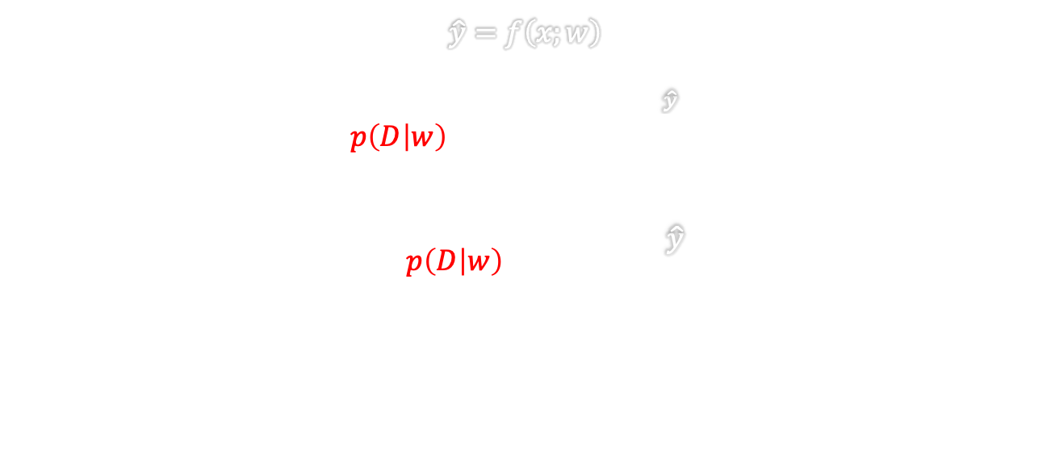
https://towardsdatascience.com/bayesian-thinking-estimating-posterior-distribution-for-linear-regression-data-ketchup-2f50a597eb06
FUNDAMENTALs
Bayes theorem
$$\hat{y}=f\left(x;w\right)$$
$$p\left(D | w\right)=\frac{1}{\sqrt{2πσ_{D}^{2} }}e^{−\frac{{\left(D−\hat{y}\right)}^{2}}{2σ_{D}^{2}}}$$
$$−log{p\left(D | w\right)}=k+\frac{{\left(D−\hat{y}\right)}^{2}}{2σ_{D}^{2}}$$
$$p\left(w | D\right)=\frac{p\left(D | w\right)p(w)}{p(D)}$$
Maximize
-$D:observed data$
-$w:parameters of regression line$
-$σ_{D}^{2}:data variance$
Minimize
$Posterior$: $p\left(w | D\right)$
$Likelihood$:$p\left(D | w\right)$
$Prior$:$p(w)$
$Evidence$:$p(D)$
Notes:
- Loss Function Introduction:
- Introduces the concept of a loss function to evaluate the model performance.
- The equation −log⁡(𝑝(𝐷│𝑤)) = 𝑘 + ((𝐷−𝑦 ̂ )^2) / (2𝜎_𝐷^2) represents the loss function based on the negative log-likelihood of the data given model parameters.
- Evaluating Model Fit:
- Discuss how the loss function quantifies the discrepancy between the observed data and predicted output.
- Emphasize that minimizing the loss function helps to improve the model's predictive accuracy.
- Importance of Loss Functions:
- Highlight the role of loss functions in training machine learning models.
- Explain how optimizing the loss function during model training enhances the model's ability to make accurate predictions.
- Optimization Process:
- Describe the optimization process of adjusting model parameters w to minimize the loss function.
- Discuss the iterative nature of model training where the loss function guides the parameter updates to improve performance.

Slide 13
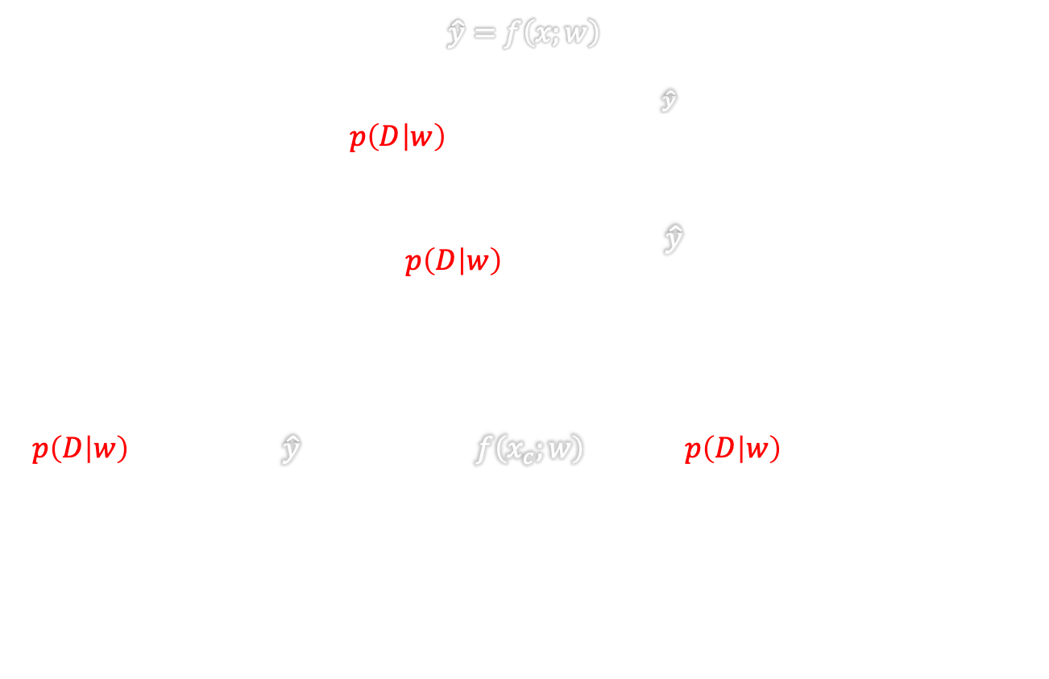
https://towardsdatascience.com/bayesian-thinking-estimating-posterior-distribution-for-linear-regression-data-ketchup-2f50a597eb06
FUNDAMENTALs
Bayes theorem
$$\hat{y}=f\left(x;w\right)$$
$$p\left(D | w\right)=\frac{1}{\sqrt{2πσ_{D}^{2} }}e^{−\frac{{\left(D−\hat{y}\right)}^{2}}{2σ_{D}^{2}}}$$
$$−log{p\left(D | w\right)}=k+\frac{{\left(D−\hat{y}\right)}^{2}}{2σ_{D}^{2}}$$
$$p\left(D | w\right)=\prod_{c}{p\left(t_{c} | {\hat{y}}_{c}\right)}=\prod_{c}{p\left(t_{c} | f\left(x_{c};w\right)\right)→log p\left(D | w\right)=\sum_{c}{log p\left(t_{c} | w\right)}⁡}$$
$$p\left(w | D\right)=\frac{p\left(D | w\right)p(w)}{p(D)}$$
-$D:observed data$
-$w:parameters of regression line$
-$σ_{D}^{2}:data variance$
$Posterior$: $p\left(w | D\right)$
$Likelihood$:$p\left(D | w\right)$
$Prior$:$p(w)$
$Evidence$:$p(D)$
Maximum likelihood
Notes:
- Probabilistic Interpretation:
- Introduces the probabilistic interpretation of the model predictions.
- The equation 𝑝(𝐷│𝑤) = ∏_𝑐 𝑝(𝑡_𝑐│𝑦 ̂_𝑐) = ∏_𝑐 𝑝(𝑡_𝑐│𝑓(𝑥_𝑐;𝑤)) illustrates the likelihood of the target data given model predictions.
- Log-Likelihood Transformation:
- Explains the transformation of the likelihood calculation into a log-likelihood form for ease of computation.
- The expression log(𝑝(𝐷│𝑤)) = ∑_𝑐 log(𝑝(𝑡_𝑐│𝑤)) simplifies the likelihood calculation by summing individual log-probabilities for each target data point.
- Model Evaluation:
- Discusses how log-likelihood serves as a metric for evaluating the model's predictive performance.
- Emphasize that maximizing the log-

Slide 14
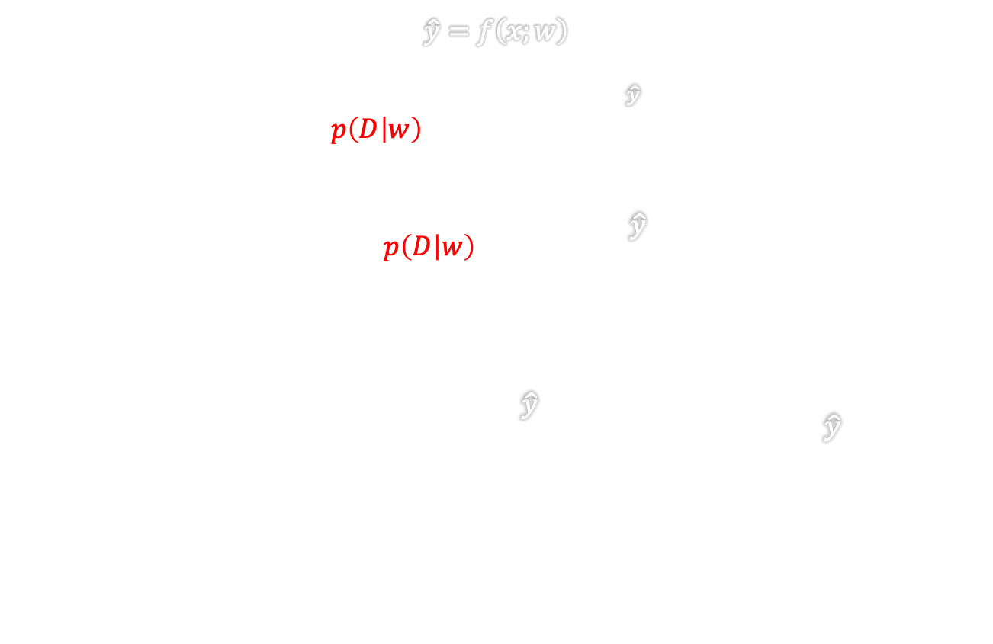
https://towardsdatascience.com/bayesian-thinking-estimating-posterior-distribution-for-linear-regression-data-ketchup-2f50a597eb06
FUNDAMENTALs
Bayes theorem
$$\hat{y}=f\left(x;w\right)$$
$$p\left(D | w\right)=\frac{1}{\sqrt{2πσ_{D}^{2} }}e^{−\frac{{\left(D−\hat{y}\right)}^{2}}{2σ_{D}^{2}}}$$
$$−log{p\left(D | w\right)}=k+\frac{{\left(D−\hat{y}\right)}^{2}}{2σ_{D}^{2}}$$
$$−\sum_{c}{\log{p\left(t_{c} | w\right)}}=\sum_{c}{k+\frac{{\left(t_{c}−{\hat{y}}_{c}\right)}^{2}}{2σ_{D}^{2}}}=K+\frac{1}{2σ_{D}^{2}}\sum_{c}{{\left(t_{c}−{\hat{y}}_{c}\right)}^{2}}$$
$$p\left(w | D\right)=\frac{p\left(D | w\right)p(w)}{p(D)}$$
-$D:observed data$
-$w:parameters of regression line$
-$σ_{D}^{2}:data variance$
$Posterior$: $p\left(w | D\right)$
$Likelihood$:$p\left(D | w\right)$
$Prior$:$p(w)$
$Evidence$:$p(D)$
Maximum likelihood
Notes:
- Revised Loss Function Transformation:
- Introduces the transformed loss function equation for model evaluation.
- The equation: −∑_𝑐 log⁡(𝑝(𝑡_𝑐│𝑤)) = ∑_𝑐 (𝑘 + (𝑡_𝑐 - 𝑦 ̂_𝑐)^2 / (2𝜎_𝐷^2)) = 𝐾 + 1 / (2𝜎_𝐷^2) ∑_𝑐 (𝑡_𝑐 - 𝑦 ̂_𝑐)^2 represents the modified loss function.
- Loss Function Interpretation:
- Explain the transformation of the log-likelihood loss into a form that emphasizes the squared errors between target values and predicted outputs.
- Emphasize the elements contributing to the total loss, including a constant term K and a term related to the sum of squared errors.
- Model Optimization:
- Discuss how minimizing the revised loss function optimizes the model parameters for improved predictive performance.
-

Slide 15
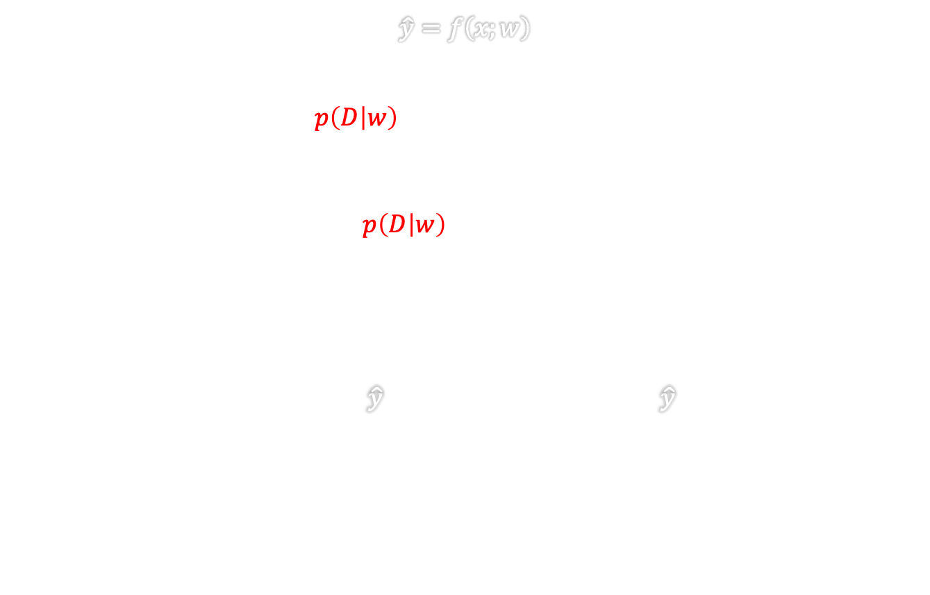
https://towardsdatascience.com/bayesian-thinking-estimating-posterior-distribution-for-linear-regression-data-ketchup-2f50a597eb06
FUNDAMENTALs
Bayes theorem
$$\hat{y}=f\left(x;w\right)$$
$$p\left(D | w\right)=\frac{1}{\sqrt{2πσ_{D}^{2} }}e^{−\frac{{\left(D−\hat{y}\right)}^{2}}{2σ_{D}^{2}}}$$
$$−log{p\left(D | w\right)}=k+\frac{{\left(D−\hat{y}\right)}^{2}}{2σ_{D}^{2}}$$
$$\frac{1}{2σ_{D}^{2}}\sum_{c}{{\left(t_{c}−{\hat{y}}_{c}\right)}^{2}}→MSE=\frac{1}{N}\sum_{c=1}^{N}{{\left(t_{c}−{\hat{y}}_{c}\right)}^{2}}$$
$$p\left(w | D\right)=\frac{p\left(D | w\right)p(w)}{p(D)}$$
-$D:observed data$
-$w:parameters of regression line$
-$σ_{D}^{2}:data variance$
$Posterior$: $p\left(w | D\right)$
$Likelihood$:$p\left(D | w\right)$
$Prior$:$p(w)$
$Evidence$:$p(D)$
Maximum likelihood
Notes:
- Mean Squared Error (MSE) Transformation:
- Introduces the revised form of loss calculation using Mean Squared Error (MSE).
- The equation: 1/(2𝜎_𝐷^2) ∑_𝑐 (𝑡_𝑐 - 𝑦 ̂_𝑐)^2 → MSE = 1/N ∑_(𝑐=1)^N (𝑡_𝑐 - 𝑦 ̂_𝑐)^2 represents the computation of the mean squared error.
- Evaluation Criteria Adjustment:
- Explains the transition to MSE as a more standardized metric for evaluating predictive performance.
- Discuss how taking the average squared error over all data points normalizes the loss by the total number of samples (N).
- Performance Measure:
- Emphasizes the significance of MSE in quantifying the discrepancy between predicted and actual values.
- Highlight the importance of minimizing MSE to enhance the model's accuracy in predicting target outputs.

Slide 16
https://towardsdatascience.com/bayesian-thinking-estimating-posterior-distribution-for-linear-regression-data-ketchup-2f50a597eb06
FUNDAMENTALs
Bayes theorem
$$\hat{y}=f\left(x;w\right)$$
$$p\left(D | w\right)=\frac{1}{\sqrt{2πσ_{D}^{2} }}e^{−\frac{{\left(D−\hat{y}\right)}^{2}}{2σ_{D}^{2}}}$$
$$−log{p\left(D | w\right)}=k+\frac{{\left(D−\hat{y}\right)}^{2}}{2σ_{D}^{2}}$$
$$\frac{1}{2σ_{D}^{2}}\sum_{c}{{\left(t_{c}−{\hat{y}}_{c}\right)}^{2}}→MSE=\frac{1}{N}\sum_{c=1}^{N}{{\left(t_{c}−{\hat{y}}_{c}\right)}^{2}}$$
$$p\left(w | D\right)=\frac{p\left(D | w\right)p(w)}{p(D)}$$
-$D:observed data$
-$w:parameters of regression line$
-$σ_{D}^{2}:data variance$
$Posterior$: $p\left(w | D\right)$
$Likelihood$:$p\left(D | w\right)$
$Prior$:$p(w)$
$Evidence$:$p(D)$
Maximum likelihood
When to use?
Notes:
No Prior Knowledge
Simplicity and Clarity
Large Sample Sizes
- Decision Consideration:
- Raises the fundamental question of when to choose Maximum Likelihood estimation over Full Bayesian methods in modeling.
- Discuss the implications of this decision on the model's performance, interpretability, and computational complexity.
- Maximum Likelihood Estimation:
- Explain that Maximum Likelihood estimation focuses on finding the parameter values that maximize the likelihood of the observed data.
- Point out that Maximum Likelihood estimation is often used when computational efficiency and simplicity are prioritized.

Slide 17
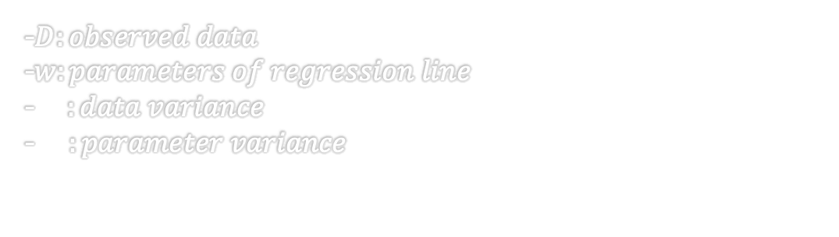
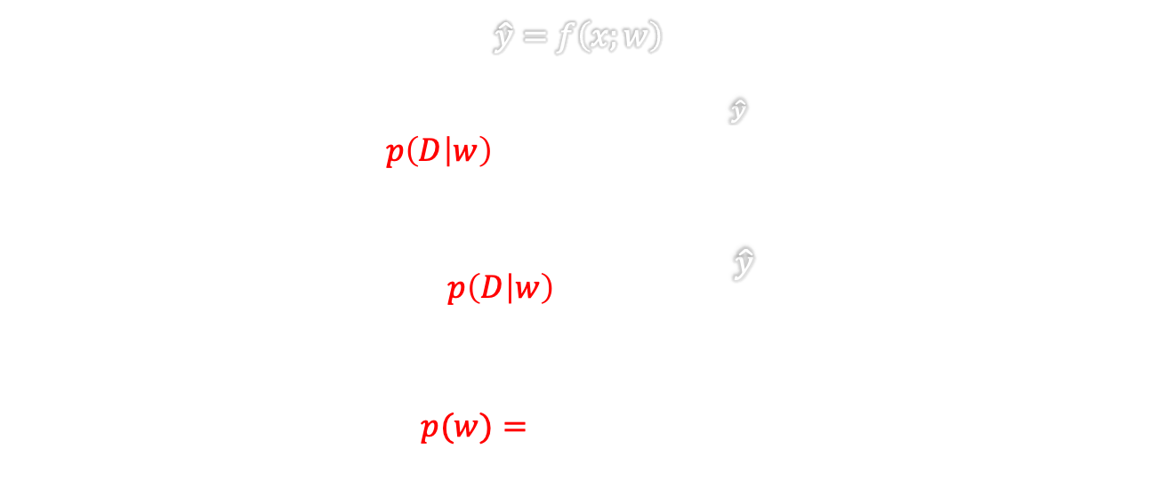
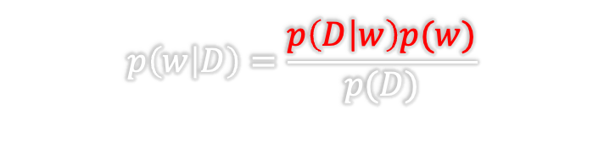
https://towardsdatascience.com/bayesian-thinking-estimating-posterior-distribution-for-linear-regression-data-ketchup-2f50a597eb06
FUNDAMENTALs
Bayes theorem
$$\hat{y}=f\left(x;w\right)$$
$$p\left(D | w\right)=\frac{1}{\sqrt{2πσ_{D}^{2} }}e^{−\frac{{\left(D−\hat{y}\right)}^{2}}{2σ_{D}^{2}}}$$
$$−log{p\left(D | w\right)}=k+\frac{{\left(D−\hat{y}\right)}^{2}}{2σ_{D}^{2}}$$
$$p(w)=\frac{1}{\sqrt{2πσ_{w}^{2}}}e^{−\frac{{\left(w\right)}^{2}}{2σ_{w}^{2}}}$$
$$p\left(w | D\right)=\frac{p\left(D | w\right)p(w)}{p(D)}$$
-$D:observed data$
-$w:parameters of regression line$
-$σ_{D}^{2}:data variance$
-$σ_{w}^{2}:parameter variance$
$Posterior$: $p\left(w | D\right)$
$Likelihood$:$p\left(D | w\right)$
$Prior$:$p(w)$
$Evidence$:$p(D)$
Notes:
- Introduction of Prior Term:
- Transition to discussing the incorporation of a prior term in the model.
- The inclusion of the prior term 𝑝(𝑤) = 1/√(2𝜋𝜎_𝑤^2) * e^(-(𝑤)^2 / (2𝜎_𝑤^2)) signifies the consideration of prior beliefs about the model parameters.
- Prior Distribution:
- Explain the prior distribution over the model parameters w that captures the prior knowledge or assumptions about the parameter values.
- Discuss how the prior term influences the posterior distribution and model inference.
- Role of Prior Information:
- Highlight the significance of incorporating prior information in Bayesian modeling.
- Emphasize that the prior term influences the posterior distribution, shaping the model's parameter estimates and uncertainties.
- Bayesian Parameter Estimation:
- Discuss how combining the likelihood, prior, and evidence terms through Bayes' Theorem leads to Bayesian parameter estimation.
- Illustrate how incorporating the prior term balances the data-driven likelihood with prior information, leading to improved model inference
- Trade off between likelihood and prior

Slide 18
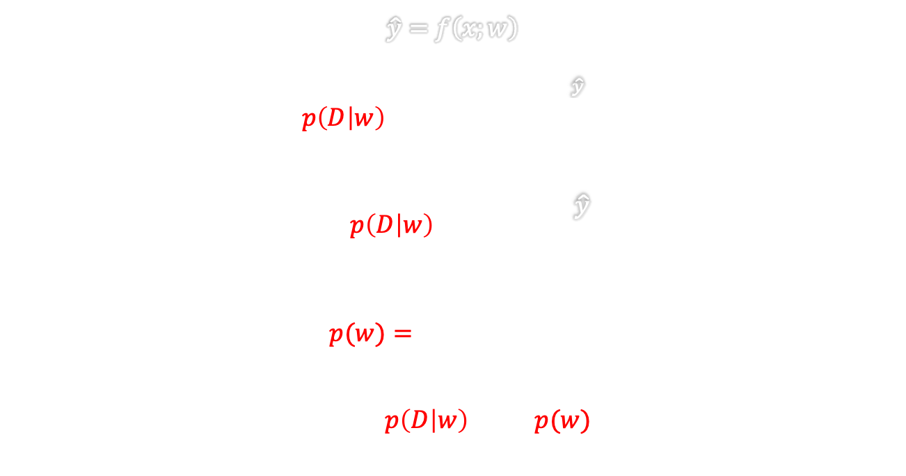
https://towardsdatascience.com/bayesian-thinking-estimating-posterior-distribution-for-linear-regression-data-ketchup-2f50a597eb06
FUNDAMENTALs
Bayes theorem
$$\hat{y}=f\left(x;w\right)$$
$$p\left(D | w\right)=\frac{1}{\sqrt{2πσ_{D}^{2} }}e^{−\frac{{\left(D−\hat{y}\right)}^{2}}{2σ_{D}^{2}}}$$
$$−log{p\left(D | w\right)}=k+\frac{{\left(D−\hat{y}\right)}^{2}}{2σ_{D}^{2}}$$
$$p(w)=\frac{1}{\sqrt{2πσ_{w}^{2}}}e^{−\frac{{\left(w\right)}^{2}}{2σ_{w}^{2}}}$$
$$log p\left(w | D\right)=\log{p\left(D | w\right){+}\log{p(w)}−\log{p(D)}}$$
$$p\left(w | D\right)=\frac{p\left(D | w\right)p(w)}{p(D)}$$
-$D:observed data$
-$w:parameters of regression line$
-$σ_{D}^{2}:data variance$
-$σ_{w}^{2}:parameter variance$
$Posterior$: $p\left(w | D\right)$
$Likelihood$:$p\left(D | w\right)$
$Prior$:$p(w)$
$Evidence$:$p(D)$
Notes:
- Bayes' Theorem Application:
- Introduces the application of Bayes' Theorem to calculate the posterior distribution over model parameters w given the data D.
- The equation log 𝑝(𝑤│𝐷) = log⁡(𝑝(𝐷│𝑤)) + log⁡(𝑝(𝑤)) - log⁡(𝑝(𝐷)) represents the posterior probability of parameters w.
- Components of Posterior Calculation:
- Explain that the posterior log probability involves the likelihood of the data given parameters, the prior probability of parameters, and the marginal likelihood of the data.
- Describe how combining these components using Bayes' Theorem results in the updated beliefs about model parameters after observing the data.
- Interpretation of the Equation:
- Discuss the significance of each term in the posterior calculation equation.
- Illustrate how the posterior distribution integrates information from the likelihood, prior, and data to refine the model parameter estimates.
- Bayesian Inference Process:
- Emphasize that the log posterior calculation

Slide 19
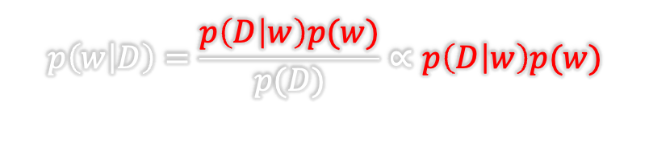
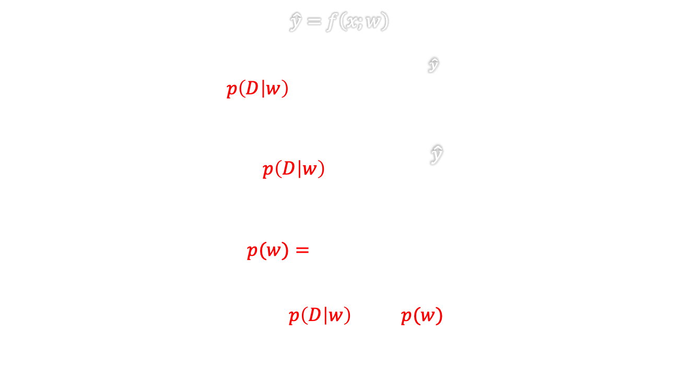
https://towardsdatascience.com/bayesian-thinking-estimating-posterior-distribution-for-linear-regression-data-ketchup-2f50a597eb06
FUNDAMENTALs
Bayes theorem
$$\hat{y}=f\left(x;w\right)$$
$$p\left(D | w\right)=\frac{1}{\sqrt{2πσ_{D}^{2} }}e^{−\frac{{\left(D−\hat{y}\right)}^{2}}{2σ_{D}^{2}}}$$
$$−log{p\left(D | w\right)}=k+\frac{{\left(D−\hat{y}\right)}^{2}}{2σ_{D}^{2}}$$
$$p(w)=\frac{1}{\sqrt{2πσ_{w}^{2}}}e^{−\frac{{\left(w\right)}^{2}}{2σ_{w}^{2}}}$$
$$log p\left(w | D\right)=\log{p\left(D | w\right){+}\log{p(w)}−\log{p(D)}}$$
$$p\left(w | D\right)=\frac{p\left(D | w\right)p(w)}{p(D)}∝p\left(D | w\right)p(w)$$
-$D:observed data$
-$w:parameters of regression line$
-$σ_{D}^{2}:data variance$
-$σ_{w}^{2}:parameter variance$
$$maximum is independent of normalization$$
$Posterior$: $p\left(w | D\right)$
$Likelihood$:$p\left(D | w\right)$
$Prior$:$p(w)$
$Evidence$:$p(D)$
Ignore this term
Notes:
- Emphasize the goal of finding the parameter values that maximize the posterior probability.
- Ignoring the Normalization Constant:
- Highlight the exclusion of the normalization term (log(p(D))) in the optimization process for finding the maximum.
- Explain that the normalization term doesn't affect the determination of the maximum value and can be disregarded.
- Independence of Normalization:
- Illustrate the concept that the location of the maximum point is independent of the normalization constant.
- Use a figure depicting two different probability density functions (PDFs) to demonstrate the independence of the maximum point from normalization.
- Visual Representation:
- Discuss the figure showing two PDFs with different normalization constants but the same maximum point.
- Explain how the shape of the distribution and the location of the maximum remain unchanged regardless of normalization.
By addressing the concepts related to MAP estimation, normalization factors, and the independence of the maximum point

Slide 20
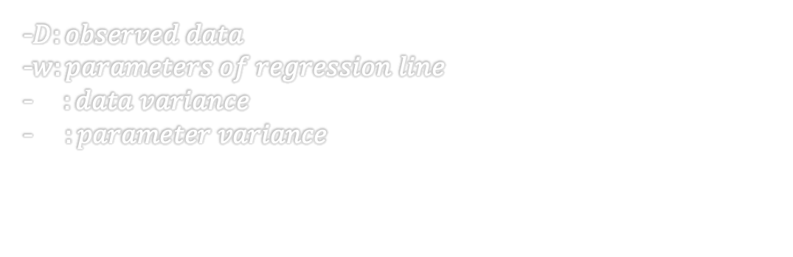

https://towardsdatascience.com/bayesian-thinking-estimating-posterior-distribution-for-linear-regression-data-ketchup-2f50a597eb06
FUNDAMENTALs
Bayes theorem
Maximum a posteriori
$$p\left(w | D\right)=\frac{p\left(D | w\right)p(w)}{p(D)}$$
$$−log p\left(w | D\right)=−log{p\left(w\right)−\log{p\left(D | w\right)}}$$
$$p\left(D | w\right)=\frac{1}{\sqrt{2πσ_{D}^{2} }}e^{−\frac{{\left(D−\hat{y}\right)}^{2}}{2σ_{D}^{2}}} , p(w)=\frac{1}{\sqrt{2πσ_{w}^{2}}}e^{−\frac{{\left(w\right)}^{2}}{2σ_{w}^{2}}}$$
-$D:observed data$
-$w:parameters of regression line$
-$σ_{D}^{2}:data variance$
-$σ_{w}^{2}:parameter variance$
$Posterior$: $p\left(w | D\right)$
$Likelihood$:$p\left(D | w\right)$
$Prior$:$p(w)$
$Evidence$:$p(D)$

Slide 21
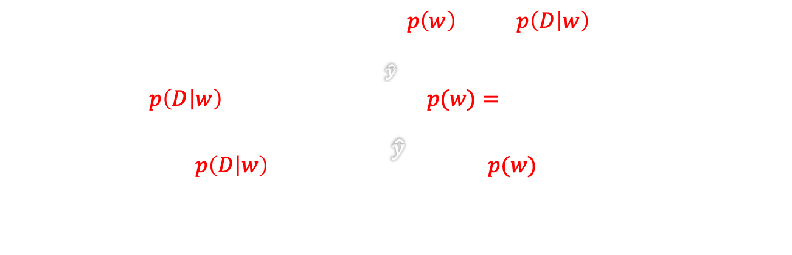
https://towardsdatascience.com/bayesian-thinking-estimating-posterior-distribution-for-linear-regression-data-ketchup-2f50a597eb06
FUNDAMENTALs
Bayes theorem
Maximum a posteriori
$$p\left(w | D\right)=\frac{p\left(D | w\right)p(w)}{p(D)}$$
$$−log p\left(w | D\right)=−log{p\left(w\right)−\log{p\left(D | w\right)}}$$
$$p\left(D | w\right)=\frac{1}{\sqrt{2πσ_{D}^{2} }}e^{−\frac{{\left(D−\hat{y}\right)}^{2}}{2σ_{D}^{2}}} , p(w)=\frac{1}{\sqrt{2πσ_{w}^{2}}}e^{−\frac{{\left(w\right)}^{2}}{2σ_{w}^{2}}}$$
$$−log{p\left(D | w\right)}=k+\frac{{\left(D−\hat{y}\right)}^{2}}{2σ_{D}^{2}},−log{p(w)}=k+\frac{w^{2}}{2σ_{w}^{2}}$$
-$D:observed data$
-$w:parameters of regression line$
-$σ_{D}^{2}:data variance$
-$σ_{w}^{2}:parameter variance$
$Posterior$: $p\left(w | D\right)$
$Likelihood$:$p\left(D | w\right)$
$Prior$:$p(w)$
$Evidence$:$p(D)$
Notes:
- Loss Function Components:
- Introduces the components of the loss function associated with the negative log likelihood of the data given the parameters and the negative log prior.
- The expressions -log(𝑝(𝐷│𝑤)) = 𝑘 + ((𝐷−ŷ)^2) / (2𝜎_𝐷^2) and -log(𝑝(𝑤)) = 𝑘 + (𝑤^2) / (2𝜎_𝑤^2) highlight the contributions of the data likelihood and prior distribution to the overall loss.
- Loss Function Interpretation:
- Discuss how the total loss function comprises the negative log likelihood and negative log prior terms, indicating the fit to the data and model complexity penalties.
- Explain that minimizing this combined loss function facilitates parameter estimation while considering both data-driven information and prior beliefs.
- Regularization Effect:
- Address the regularization effect introduced by the prior term in the loss

Slide 22
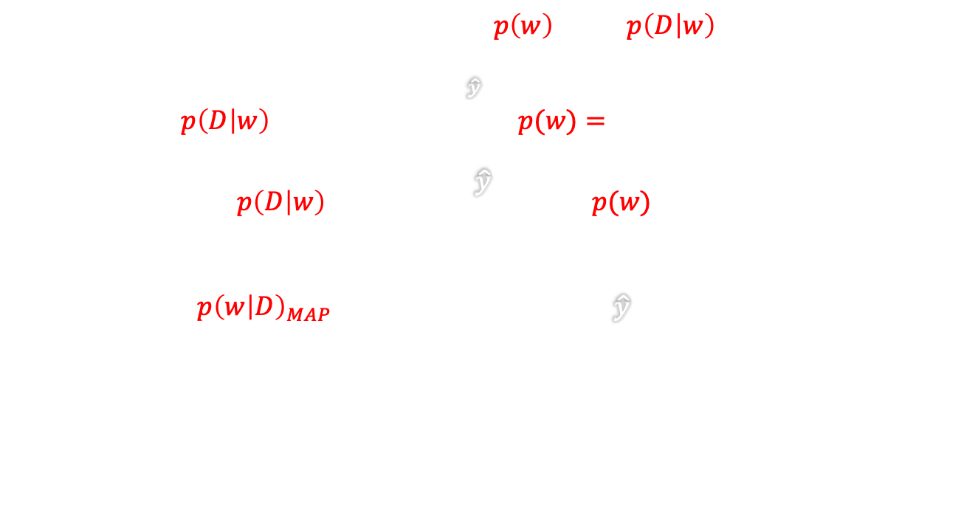
https://towardsdatascience.com/bayesian-thinking-estimating-posterior-distribution-for-linear-regression-data-ketchup-2f50a597eb06
FUNDAMENTALs
Bayes theorem
Maximum a posteriori
$$p\left(w | D\right)=\frac{p\left(D | w\right)p(w)}{p(D)}$$
$$−log p\left(w | D\right)=−log{p\left(w\right)−\log{p\left(D | w\right)}}$$
$$p\left(D | w\right)=\frac{1}{\sqrt{2πσ_{D}^{2} }}e^{−\frac{{\left(D−\hat{y}\right)}^{2}}{2σ_{D}^{2}}} , p(w)=\frac{1}{\sqrt{2πσ_{w}^{2}}}e^{−\frac{{\left(w\right)}^{2}}{2σ_{w}^{2}}}$$
$$−log{p\left(D | w\right)}=k+\frac{{\left(D−\hat{y}\right)}^{2}}{2σ_{D}^{2}},−log{p(w)}=k+\frac{w^{2}}{2σ_{w}^{2}}$$
$$−log p{\left(w | D\right)}_{MAP}=Cost=\frac{1}{2σ_{D}^{2}}\sum_{c}{{\left(t_{c}−{\hat{y}}_{c}\right)}^{2}}+\frac{1}{2σ_{w}^{2}}\sum_{i}{w_{i}^{2}}$$
-$D:observed data$
-$w:parameters of regression line$
-$σ_{D}^{2}:data variance$
-$σ_{w}^{2}:parameter variance$
$Posterior$: $p\left(w | D\right)$
$Likelihood$:$p\left(D | w\right)$
$Prior$:$p(w)$
$Evidence$:$p(D)$
Notes:
- Negative Log Posterior under MAP:
- Introduces the negative log posterior under Maximum A Posteriori (MAP) estimation as the Total Cost function.
- The equation -log 𝑝(𝑤│𝐷)𝑀𝐴𝑃 = Cost = (1/(2𝜎_𝐷^2)) ∑_𝑐(𝑡_𝑐−ŷ_𝑐)^2 + (1/(2𝜎_𝑤^2)) ∑_i 𝑤_i^2 represents the total cost incorporating data loss and regularization terms.
- Cost Function Interpretation:
- Discuss the interpretation of the total cost function, where the first term represents the data-fitting component and the second term reflects the regularization effect.
- Emphasize the balance between minimizing the data loss for accurate predictions and controlling the model complexity through regularization.
- Parameter Estimation Objective:
- Highlight that minimizing the negative log posterior under MAP estimation aims to find the optimal parameter values that balance data fidelity and regularization.
- Explain how the total cost encapsulates both the goodness of fit to the data and the penalization for large parameter values.
- Optimization Goal:
- Explain that the Total Cost function guides the optimization process in MAP estimation by considering the trade-off between data fidelity and regularization.

Slide 23
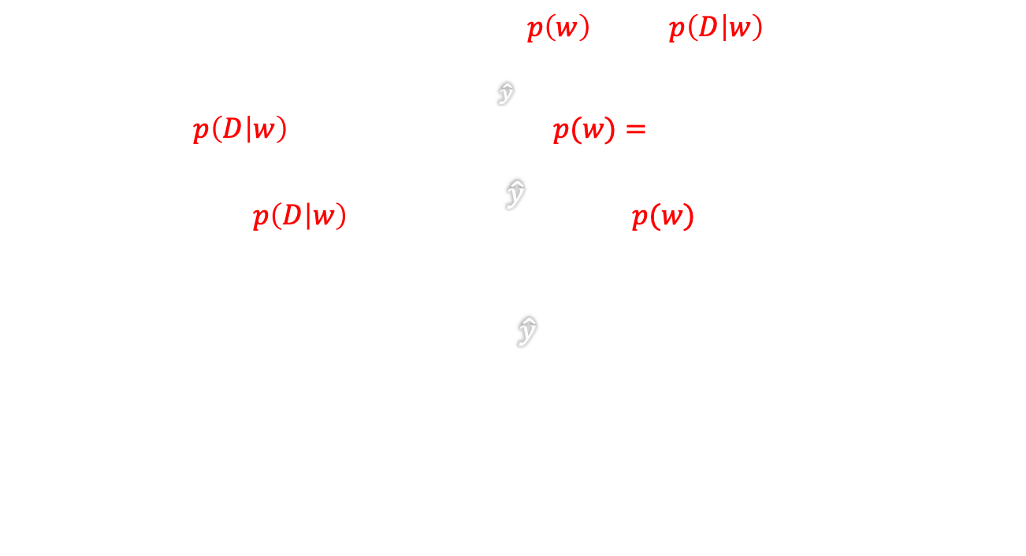
https://towardsdatascience.com/bayesian-thinking-estimating-posterior-distribution-for-linear-regression-data-ketchup-2f50a597eb06
FUNDAMENTALs
Bayes theorem
Maximum a posteriori
$$p\left(w | D\right)=\frac{p\left(D | w\right)p(w)}{p(D)}$$
$$−log p\left(w | D\right)=−log{p\left(w\right)−\log{p\left(D | w\right)}}$$
$$p\left(D | w\right)=\frac{1}{\sqrt{2πσ_{D}^{2} }}e^{−\frac{{\left(D−\hat{y}\right)}^{2}}{2σ_{D}^{2}}} , p(w)=\frac{1}{\sqrt{2πσ_{w}^{2}}}e^{−\frac{{\left(w\right)}^{2}}{2σ_{w}^{2}}}$$
$$−log{p\left(D | w\right)}=k+\frac{{\left(D−\hat{y}\right)}^{2}}{2σ_{D}^{2}},−log{p(w)}=k+\frac{w^{2}}{2σ_{w}^{2}}$$
$$Cost^{∗}=\sum_{c}{{\left(t_{c}−{\hat{y}}_{c}\right)}^{2}}+\frac{σ_{D}^{2}}{σ_{w}^{2}}\sum_{i}{w_{i}^{2}}$$
-$D:observed data$
-$w:parameters of regression line$
-$σ_{D}^{2}:data variance$
-$σ_{w}^{2}:parameter variance$
$Posterior$: $p\left(w | D\right)$
$Likelihood$:$p\left(D | w\right)$
$Prior$:$p(w)$
$Evidence$:$p(D)$

Slide 24
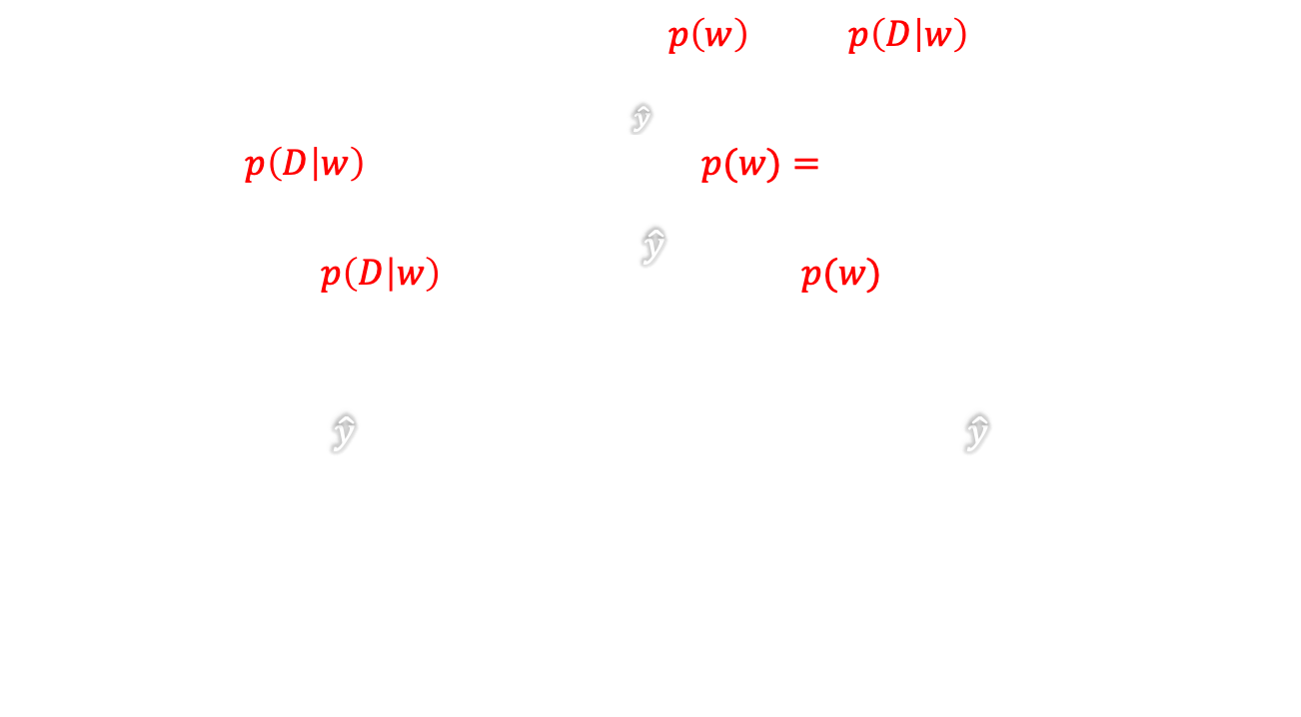
https://towardsdatascience.com/bayesian-thinking-estimating-posterior-distribution-for-linear-regression-data-ketchup-2f50a597eb06
FUNDAMENTALs
Bayes theorem
Maximum a posteriori
$$p\left(w | D\right)=\frac{p\left(D | w\right)p(w)}{p(D)}$$
$$−log p\left(w | D\right)=−log{p\left(w\right)−\log{p\left(D | w\right)}}$$
$$p\left(D | w\right)=\frac{1}{\sqrt{2πσ_{D}^{2} }}e^{−\frac{{\left(D−\hat{y}\right)}^{2}}{2σ_{D}^{2}}} , p(w)=\frac{1}{\sqrt{2πσ_{w}^{2}}}e^{−\frac{{\left(w\right)}^{2}}{2σ_{w}^{2}}}$$
$$−log{p\left(D | w\right)}=k+\frac{{\left(D−\hat{y}\right)}^{2}}{2σ_{D}^{2}},−log{p(w)}=k+\frac{w^{2}}{2σ_{w}^{2}}$$
$$Cost^{∗}=\sum_{c}{{\left(t_{c}−{\hat{y}}_{c}\right)}^{2}}+\frac{σ_{D}^{2}}{σ_{w}^{2}}\sum_{i}{w_{i}^{2}}→Cost^{⋄}=\frac{1}{N}\sum_{c=1}^{N}{{\left(t_{c}−{\hat{y}}_{c}\right)}^{2}}+λ\frac{1}{M}\sum_{i=1}^{M}{w_{i}^{2}}$$
-$D:observed data$
-$w:parameters of regression line$
-$σ_{D}^{2}:data variance$
-$σ_{w}^{2}:parameter variance$
$Posterior$: $p\left(w | D\right)$
$Likelihood$:$p\left(D | w\right)$
$Prior$:$p(w)$
$Evidence$:$p(D)$
Weight decay
Notes:
- Refined Cost Function:
- Introduce the refined form of the cost function equation to incorporate regularization and balancing terms.
- The equation 𝐶𝑜𝑠𝑡^⋄ = (1/𝑁) ∑_(𝑐=1)^𝑁 (𝑡_𝑐−ŷ_𝑐)^2 + 𝜆 (1/𝑀) ∑_(𝑖=1)^𝑀 𝑤_i^2 signifies the total cost with a data fidelity component, regularization term, and regularization parameter λ.
- Enhanced Cost Function Interpretation:
- Discuss the interpretation of the refined cost function, emphasizing the components related to data fitting and model complexity regularization.
- Highlight the role of the regularization parameter λ in controlling the influence of the regularization term on the optimization process.
- Regularization Parameter Adjustment:
- Explain the significance of the regularization parameter λ in balancing the trade-off between data accuracy and model simplicity.
- Address how tuning the λ value impacts the weighting between the data fidelity and regularization terms.
- Optimization Objective:
- Emphasize that the refined cost function provides a more comprehensive framework for parameter estimation, allowing for flexibility in managing the model's complexity.

Slide 25
https://towardsdatascience.com/bayesian-thinking-estimating-posterior-distribution-for-linear-regression-data-ketchup-2f50a597eb06
FUNDAMENTALs
Bayes theorem
Maximum a posteriori
$$p\left(w | D\right)=\frac{p\left(D | w\right)p(w)}{p(D)}$$
$$−log p\left(w | D\right)=−log{p\left(w\right)−\log{p\left(D | w\right)}}$$
$$p\left(D | w\right)=\frac{1}{\sqrt{2πσ_{D}^{2} }}e^{−\frac{{\left(D−\hat{y}\right)}^{2}}{2σ_{D}^{2}}} , p(w)=\frac{1}{\sqrt{2πσ_{w}^{2}}}e^{−\frac{{\left(w\right)}^{2}}{2σ_{w}^{2}}}$$
$$−log{p\left(D | w\right)}=k+\frac{{\left(D−\hat{y}\right)}^{2}}{2σ_{D}^{2}},−log{p(w)}=k+\frac{w^{2}}{2σ_{w}^{2}}$$
$$Cost^{∗}=\sum_{c}{{\left(t_{c}−{\hat{y}}_{c}\right)}^{2}}+\frac{σ_{D}^{2}}{σ_{w}^{2}}\sum_{i}{w_{i}^{2}}→Cost^{⋄}=\frac{1}{N}\sum_{c=1}^{N}{{\left(t_{c}−{\hat{y}}_{c}\right)}^{2}}+λ\frac{1}{M}\sum_{i=1}^{M}{w_{i}^{2}}$$
-$D:observed data$
-$w:parameters of regression line$
-$σ_{D}^{2}:data variance$
-$σ_{w}^{2}:parameter variance$
$Posterior$: $p\left(w | D\right)$
$Likelihood$:$p\left(D | w\right)$
$Prior$:$p(w)$
$Evidence$:$p(D)$
When to use?
Weight decay

Slide 26
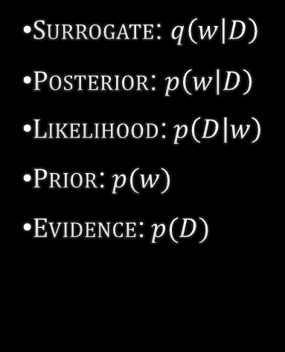
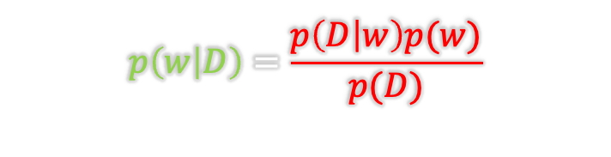
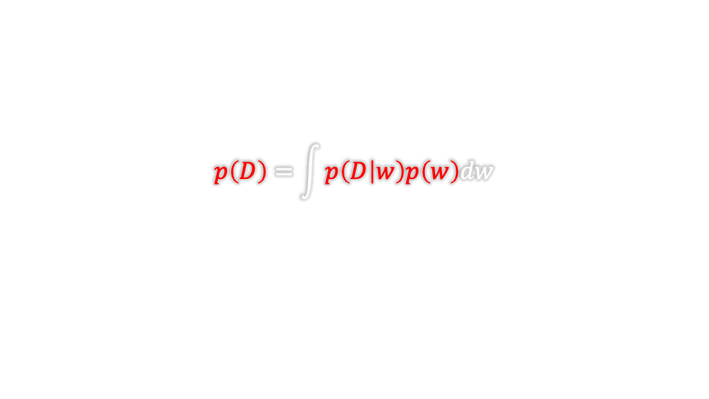
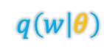
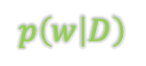
https://towardsdatascience.com/bayesian-thinking-estimating-posterior-distribution-for-linear-regression-data-ketchup-2f50a597eb06
FUNDAMENTALs
Bayes theorem
Full Bayesian?
$$p\left(w | D\right)=\frac{p\left(D | w\right)p(w)}{p(D)}$$
$$p\left(D\right)=\int{p\left(D | w\right)p\left(w\right)dw}$$
$Surrogate$: $q\left(w | D\right)$
$Posterior$: $p\left(w | D\right)$
$Likelihood$:$p\left(D | w\right)$
$Prior$:$p(w)$
$Evidence$:$p(D)$
$$p\left(w | D\right)$$
$$q\left(w | θ\right)$$
Notes:
Fordeling og sampling av vektene -> sample flere modeller
Hvorfor gir det mening

Slide 27

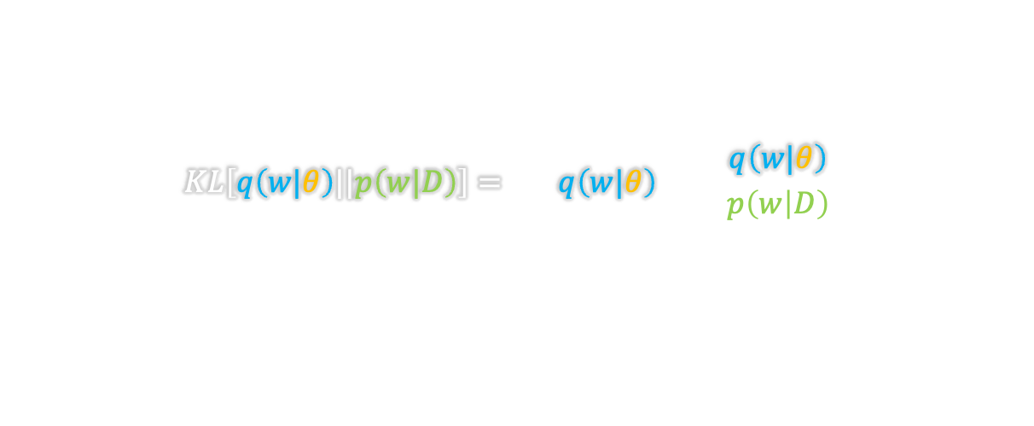
https://towardsdatascience.com/bayesian-thinking-estimating-posterior-distribution-for-linear-regression-data-ketchup-2f50a597eb06
FUNDAMENTALs
Bayes theorem
Full Bayesian?
$$p\left(w | D\right)=\frac{p\left(D | w\right)p(w)}{p(D)}$$
Kullback-Leibler (KL) Divergence
$$KL\left[q\left(w|θ\right)||p\left(w|D\right)\right]=\sum_{w}{q\left(w|θ\right)\log\left(\frac{q\left(w|θ\right)}{p\left(w | D\right)}\right)}$$
$$p\left(D\right)=\int{p\left(D | w\right)p\left(w\right)dw}$$
$Surrogate$: $q\left(w | D\right)$
$Posterior$: $p\left(w | D\right)$
$Likelihood$:$p\left(D | w\right)$
$Prior$:$p(w)$
$Evidence$:$p(D)$
$$p\left(w | D\right)$$
$$q\left(w | θ\right)$$

Slide 28

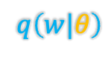
https://towardsdatascience.com/bayesian-thinking-estimating-posterior-distribution-for-linear-regression-data-ketchup-2f50a597eb06
FUNDAMENTALs
Bayes theorem
Full Bayesian?
$$p\left(w | D\right)=\frac{p\left(D | w\right)p(w)}{p(D)}$$
Kullback-Leibler (KL) Divergence
$$KL\left[q\left(w|θ\right)||p\left(w|D\right)\right]=\sum_{w}{q\left(w|θ\right)\log\left(\frac{q\left(w|θ\right)}{p\left(w | D\right)}\right)}$$
$$p\left(D\right)=\int{p\left(D | w\right)p\left(w\right)dw}$$
Variational free energy or expected lower bound
(Saul et al., 1996, Neal and Hinton, 1998)
$Surrogate$: $q\left(w | D\right)$
$Posterior$: $p\left(w | D\right)$
$Likelihood$:$p\left(D | w\right)$
$Prior$:$p(w)$
$Evidence$:$p(D)$
$$p\left(w | D\right)$$
$$θ^{∗}=\arg{\min_{θ}{KL\left[q\left(w|θ\right)||p\left(w\right)\right]−E\left[\log\left(p(D|w)\right)\right]}}$$
$$q\left(w|θ\right)$$

Slide 29
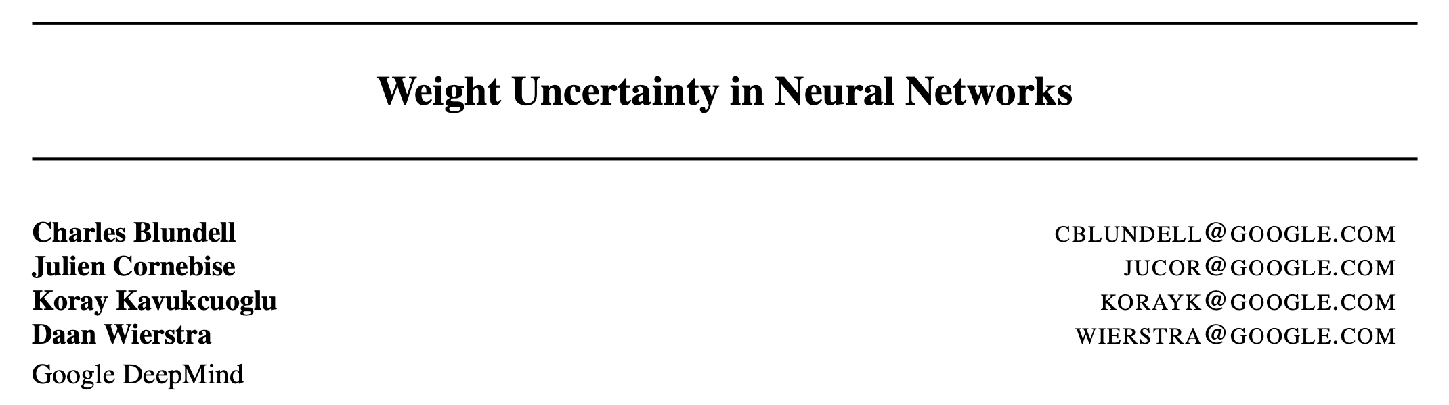
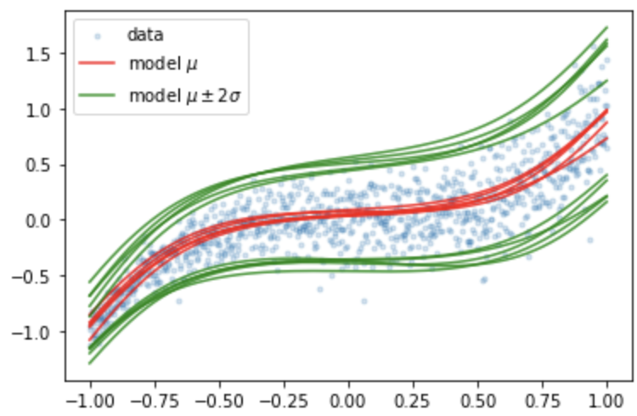

https://towardsdatascience.com/bayesian-thinking-estimating-posterior-distribution-for-linear-regression-data-ketchup-2f50a597eb06
FUNDAMENTALs
Bayes theorem
Full Bayesian? Do we need it?
$$p\left(w | D\right)=\frac{p\left(D | w\right)p(w)}{p(D)}$$
Variational free energy or expected lower bound
(Saul et al., 1996, Neal and Hinton, 1998)
$$θ^{∗}=\arg{\min_{θ}{KL\left[q\left(w|θ\right)||p\left(w\right)\right]−E\left[\log\left(p(D|w)\right)\right]}}$$
$$p\left(D\right)=\int{p\left(D | w\right)p\left(w\right)dw}$$
$Surrogate$: $q\left(w | D\right)$
$Posterior$: $p\left(w | D\right)$
$Likelihood$:$p\left(D | w\right)$
$Prior$:$p(w)$
$Evidence$:$p(D)$
$$p\left(w | D\right)$$
$$Aleatoric uncertainty$$
$$Epistemic uncertainty$$
$$q\left(w|θ\right)$$
Notes:
So the lesson is that using maximum likelihood

Slide 30
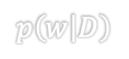
https://towardsdatascience.com/bayesian-thinking-estimating-posterior-distribution-for-linear-regression-data-ketchup-2f50a597eb06
FUNDAMENTALs
Bayes theorem
Full Bayesian? Do we need it?
$$p\left(w | D\right)=\frac{p\left(D | w\right)p(w)}{p(D)}$$
🥵
Variational free energy or expected lower bound
(Saul et al., 1996, Neal and Hinton, 1998)
$$θ^{∗}=\arg{\min_{θ}{KL\left[q\left(w|θ\right)||p\left(w\right)\right]−E\left[\log\left(p(D|w)\right)\right]}}$$
$$p\left(D\right)=\int{p\left(D | w\right)p\left(w\right)dw}$$
$Surrogate$: $q\left(w | D\right)$
$Posterior$: $p\left(w | D\right)$
$Likelihood$:$p\left(D | w\right)$
$Prior$:$p(w)$
$Evidence$:$p(D)$
$$p\left(w | D\right)$$
$$Aleatoric uncertainty$$
$$Epistemic uncertainty$$
$$q\left(w|θ\right)$$
Notes:
So the lesson is that using maximum likelihood

Slide 31
“Motivating” examples

Slide 32



Do I have the disease?
$$p\left(A | B\right)=\frac{p\left(B | A\right)p(A)}{p(B)}$$
https://www.youtube.com/watch?v=R13BD8qKeTg&t=254s
Test sample

Slide 33

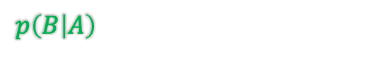
Do I have the disease?
$$p\left(A | B\right)=\frac{p\left(B | A\right)p(A)}{p(B)}$$
https://www.youtube.com/watch?v=R13BD8qKeTg&t=254s
A: have the disease
B: test positive
Test positive
$p\left(B | A\right)$: 0.99 (very accurate test)

Slide 34
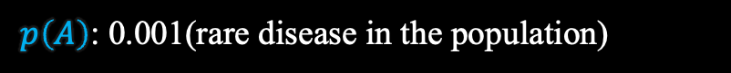

Do I have the disease?
$$p\left(A | B\right)=\frac{p\left(B | A\right)p(A)}{p(B)}$$
https://www.youtube.com/watch?v=R13BD8qKeTg&t=254s
?
A: have the disease
B: test positive
Test positive
$p\left(B | A\right)$: 0.99 (very accurate test)
$p\left(A\right)$: 0.001(rare disease in the population)

Slide 35
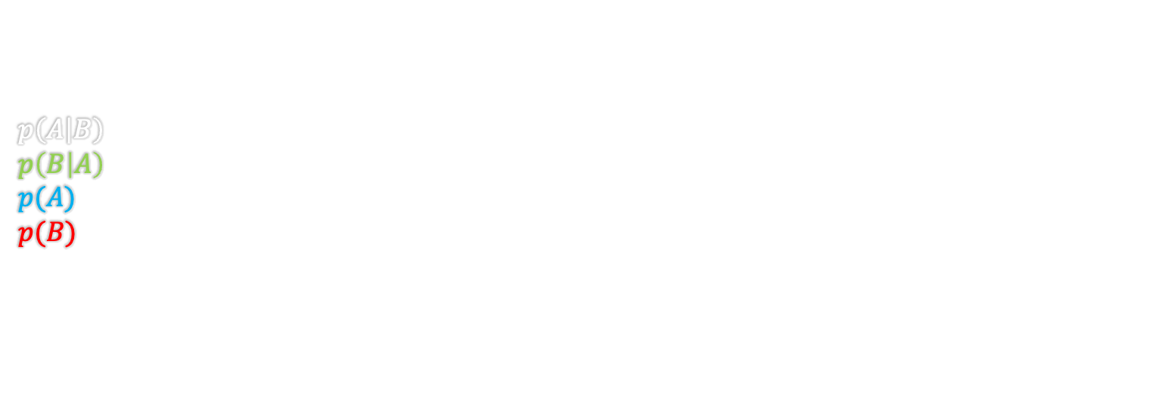

Do I have the disease?
$$p\left(A | B\right)=\frac{p\left(B | A\right)p(A)}{p(B)}$$
https://www.youtube.com/watch?v=R13BD8qKeTg&t=254s
?
A: have the disease
B: test positive
$p\left(A | B\right)$: have the disease |given| test positive
$p\left(B | A\right)$: test positive |given| have the disease - 0.99 (very accurate test)
$p(A)$: have the disease - 0.001(rare disease in the population)
$p(B)$: test positive

Slide 36
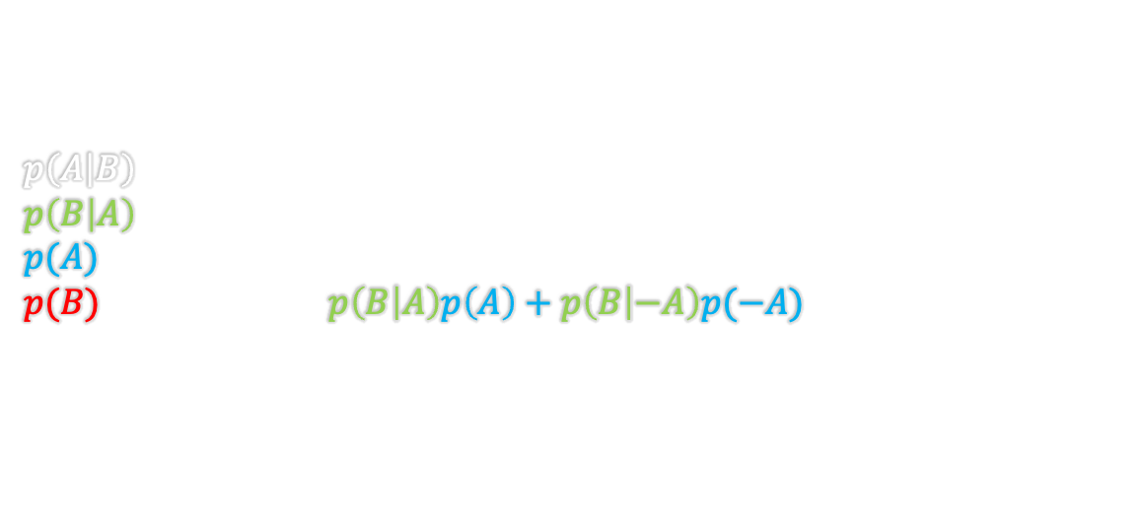
Do I have the disease?
$$p\left(A | B\right)=\frac{p\left(B | A\right)p(A)}{p(B)}$$
https://www.youtube.com/watch?v=R13BD8qKeTg&t=254s
?
A: have the disease
B: test positive
$p\left(A | B\right)$: have the disease |given| test positive
$p\left(B | A\right)$: test positive |given| have the disease - 0.99 (very accurate test)
$p(A)$: have the disease - 0.001(rare disease in the population)
$p(B)$: test positive - $p\left(B | A\right)p\left(A\right)+p\left(B | −A\right)p(−A)$
$$p\left(A | B\right)=\frac{0.99∗0.001}{0.99∗0.001+0.01∗0.999}=0.09→9\% chance 🤔$$

Slide 37
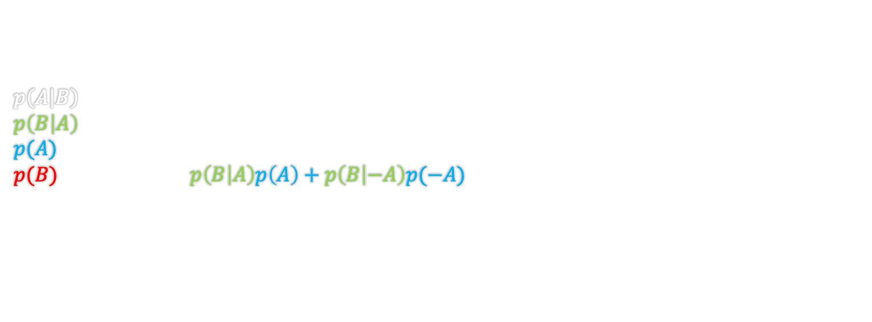
Do I have the disease?
$$p\left(A | B\right)=\frac{p\left(B | A\right)p(A)}{p(B)}$$
https://www.youtube.com/watch?v=R13BD8qKeTg&t=254s
Test sample
A: have the disease
B: test positive
$p\left(A | B\right)$: have the disease |given| test positive
$p\left(B | A\right)$: test positive |given| have the disease - 0.99 (very accurate test)
$p(A)$: have the disease - 0.001(rare disease in the population)
$p(B)$: test positive - $p\left(B | A\right)p\left(A\right)+p\left(B | −A\right)p(−A)$
Test positive
$$p\left(A | B\right)=\frac{0.99∗0.001}{0.99∗0.001+0.01∗0.999}=0.09→9\% chance 🤔$$
$$p\left(A | B\right)=\frac{0.99∗0.09}{0.99∗0.09+0.01∗0.91}=0.9073319→91\% chance$$

Slide 38
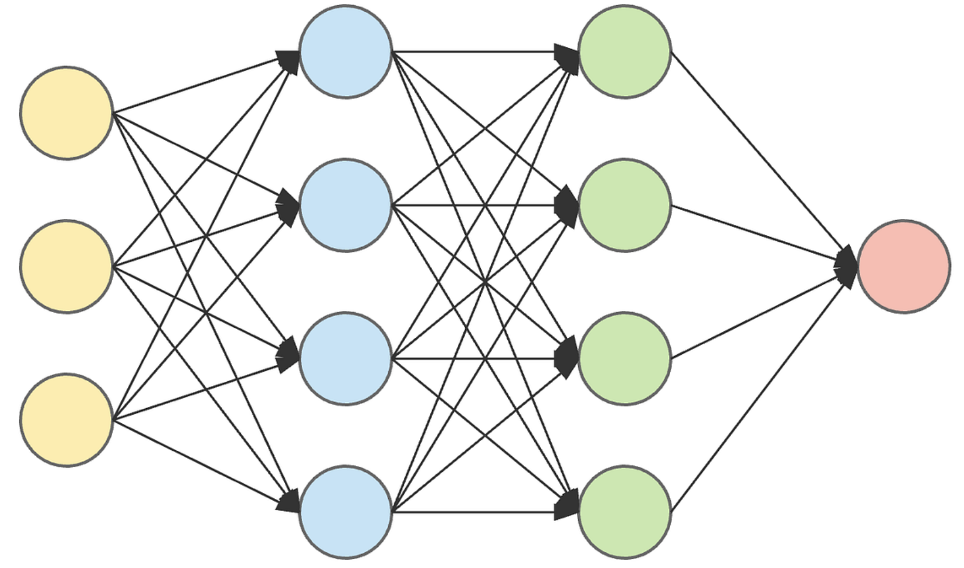

Doctor vs. Neural net
The deterministic doctor
The deterministic NN
50
45
5
100 Cases
Easy | Normal | Hard

Slide 39
Doctor vs. Neural net
The deterministic doctor
The deterministic NN
 | Easy | Normal | Hard
TP+TN | 45 | 35 | 4
FP | 5 | 9 | 1
FN | 0 | 1 | 0
50
45
5
100 Cases
Easy | Normal | Hard

Slide 40
Doctor vs. Neural net
The deterministic doctor
The deterministic NN
Score: 84/100
 | Easy | Normal | Hard
TP+TN | 45 | 35 | 4
FP | 5 | 9 | 1
FN | 0 | 1 | 0
50
45
5
100 Cases
Easy | Normal | Hard

Slide 41
Doctor vs. Neural net
The deterministic doctor
The deterministic NN
Score: 84/100
 | Easy | Normal | Hard
TP+TN | 45 | 35 | 4
FP | 5 | 9 | 1
FN | 0 | 1 | 0
 | Easy | Normal | Hard
TP+TN | 50 | 42 | 1
FP | 0 | 0 | 1
FN | 0 | 3 | 3
50
45
5
100 Cases
Easy | Normal | Hard
Notes:
What is the problem here?
Why are they disagreeing so much?

Slide 42
Doctor vs. Neural net
The deterministic doctor
The deterministic NN
Score: 84/100
Score: 93/100
 | Easy | Normal | Hard
TP+TN | 45 | 35 | 4
FP | 5 | 9 | 1
FN | 0 | 1 | 0
 | Easy | Normal | Hard
TP+TN | 50 | 42 | 1
FP | 0 | 0 | 1
FN | 0 | 3 | 3
50
45
5
100 Cases
Easy | Normal | Hard
Notes:
What is the problem here?
Why are they disagreeing so much on FP/FN?

Slide 43
Doctor vs. Neural net
The deterministic doctor
The deterministic NN
Score: 84/100
Score: 93/100
 | Easy | Normal | Hard
TP+TN | 45 | 35 | 4
FP | 5 | 9 | 1
FN | 0 | 1 | 0
 | Easy | Normal | Hard
TP+TN | 50 | 42 | 1
FP | 0 | 0 | 1
FN | 0 | 3 | 3
Who (actually) did the better job?
50
45
5
100 Cases
Easy | Normal | Hard
Notes:
What is the problem here?
Why are they disagreeing so much on FP/FN?

Slide 44
Doctor vs. Neural net
The deterministic doctor
The deterministic NN
Score: 84/100
Score: 93/100
 | Easy | Normal | Hard
TP+TN | 45 | 35 | 4
FP | 5 | 9 | 1
FN | 0 | 1 | 0
Disagreements?
 | Easy | Normal | Hard
TP+TN | 50 | 42 | 1
FP | 0 | 0 | 1
FN | 0 | 3 | 3
Who (actually) did the better job?
What does lov… uncertainty got to do with it?
50
45
5
100 Cases
Easy | Normal | Hard
Notes:
What is the problem here?
Why are they disagreeing so much on FP/FN?

Slide 45








Doctor vs. Neural net
Hard
$$x_{0}$$
$$C(lass)=P(ositive)$$
doctor
NN
$$p(C|X=x_{0})$$
$$p(C|X=x_{0})$$
Decicion boundry
$$P$$
$$N$$
$$P$$
$$N$$
Notes:
Why are they disagreeing, what are they disagreeing about?

Slide 46



Doctor vs. Neural net
Hard
$$x_{0}$$
$$C=P$$
doctor
NN
$$p(C|X=x_{0})$$
$$p(C|X=x_{0})$$
Decicion boundry
$$p(C|X=x_{0})$$
$$P$$
$$N$$
$$P$$
$$N$$
$$P$$
$$N$$

Slide 47



Doctor vs. Neural net
Hard
$$x_{0}$$
$$C=P$$
NN1
NN2
100/1000/10000 …. Predictions from different NNs
$$p(C|X=x_{0})$$
$$p(C|X=x_{0})$$
$$…$$
$$→$$
$$p(C|X=x_{0})$$
$$P$$
$$N$$
$$P$$
$$N$$
$$P$$
$$N$$

Slide 48




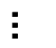
Dog vs. Cat
Training
CNN
Dog
Dog
Cat
Dog
$$…$$

Slide 49



Dog vs. Cat
Training
Inference
CNN
CNN
0.9
Dog
Cat
Dog
Dog
Cat
Dog
$$…$$

Slide 50
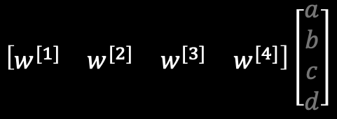
Dog vs. Cat
Inference
CNN
0.9
Cat
Dog
$$\left[\begin{matrix}w^{[1]} & w^{[2]} & w^{[3]} & w^{[4]}\end{matrix}\right]\left[\begin{matrix}a \\ b \\ c \\ d\end{matrix}\right]$$

Slide 51
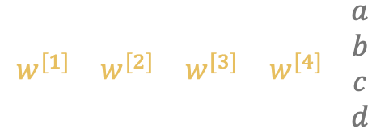
Dog vs. Cat
Inference
CNN
0.9
Cat
Dog
$$\left[\begin{matrix}w^{[1]} & w^{[2]} & w^{[3]} & w^{[4]}\end{matrix}\right]\left[\begin{matrix}a \\ b \\ c \\ d\end{matrix}\right]$$

Slide 52

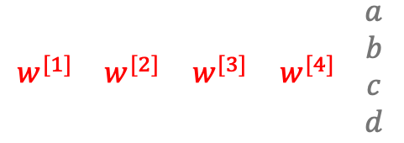
Dog vs. Cat
Inference
CNN
0.9
Cat
Dog
$$…$$
$$\left[\begin{matrix}w^{[1]} & w^{[2]} & w^{[3]} & w^{[4]}\end{matrix}\right]\left[\begin{matrix}a \\ b \\ c \\ d\end{matrix}\right]$$

Slide 53
Dog vs. Cat
Inference
CNN
0.9
Cat
Dog
$$…$$
Cat
Dog

Slide 54
Dog vs. Cat
Inference
CNN
0.9
Cat
Dog
$$…$$
Cat
Dog
Many more layers!

Slide 55


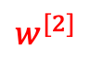
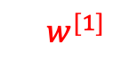
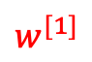
Dog vs. Cat
The deterministic NN
Inference
CNN
0.9
Cat
Dog
$$…$$
Cat
Dog
$$\left[\begin{matrix}w^{[1]} & w^{[2]} & w^{[3]} & w^{[4]}\end{matrix}\right]\left[\begin{matrix}a \\ b \\ c \\ d\end{matrix}\right]$$
$$p(w^{[1]})$$
$$p(w^{[2]})$$
$$…$$
$$w^{[1]}$$
$$w^{[2]}$$

Slide 56
Dog vs. Cat
The stochastic NN
Inference
CNN
0.9
Cat
Dog
$$…$$
Cat
Dog
$$\left[\begin{matrix}w^{[1]} & w^{[2]} & w^{[3]} & w^{[4]}\end{matrix}\right]\left[\begin{matrix}a \\ b \\ c \\ d\end{matrix}\right]$$
$$p(w^{[1]})$$
$$p(w^{[2]})$$
$$…$$
$$w^{[1]}$$
$$w^{[2]}$$

Slide 57

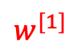
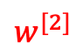
Dog vs. Cat
The stochastic NN
Inference
Sampled weights dims the collar
CNN
0.9
Cat
Dog
$$…$$
Cat
Dog
$$\left[\begin{matrix}w^{[1]} & w^{[2]} & w^{[3]} & w^{[4]}\end{matrix}\right]\left[\begin{matrix}a \\ b \\ c \\ d\end{matrix}\right]$$
$$p(w^{[1]})$$
$$p(w^{[2]})$$
$$…$$
$$w^{[1]}$$
$$w^{[2]}$$

Slide 58



Dog vs. Cat
Inference
CNN
CNN
0.9
Dog
Cat
Dog
Dog
Cat
Dog
$$L$$
$$…$$
$$f\left(x;w\right)=σ\left(w_{2}\left(w_{1}ρ\left(w_{0}x+b_{0}\right)+b_{1}\right)+b_{2}\right)→L\left(w\right)$$
$$w$$

Slide 59
Dog vs. Cat
Inference
CNN
CNN
0.9
Dog
Cat
Dog
Dog
Cat
Dog
Mode
$$L$$
$$…$$
$$f\left(x;w\right)=σ\left(w_{2}\left(w_{1}ρ\left(w_{0}x+b_{0}\right)+b_{1}\right)+b_{2}\right)→L\left(w\right)$$
$$w$$

Slide 60
Dog vs. Cat
Inference
CNN
CNN
0.9
Dog
Cat
Dog
Dog
Cat
Dog
Sample 1
$$L$$
$$…$$
$$f\left(x;w\right)=σ\left(w_{2}\left(w_{1}ρ\left(w_{0}x+b_{0}\right)+b_{1}\right)+b_{2}\right)→L\left(w\right)$$
$$w$$

Slide 61
Dog vs. Cat
Inference
CNN
CNN
0.75
Dog
Cat
Dog
Dog
Cat
Dog
Sample 2
$$L$$
$$…$$
$$f\left(x;w\right)=σ\left(w_{2}\left(w_{1}ρ\left(w_{0}x+b_{0}\right)+b_{1}\right)+b_{2}\right)→L\left(w\right)$$
$$w$$

Slide 62


Doctor vs. Neural net
Hard
$$x_{0}$$
$$C=P$$
Sample 1
Sample 2
Sample N
NN
NN
100/1000/10000 …. Predictions from different NNs
$$p(C|X=x_{0})$$
$$p(C|X=x_{0})$$
$$…$$
$$p(C|X=x_{0})$$
$$P$$
$$N$$
$$P$$
$$N$$
$$P$$
$$N$$

Slide 63
Doctor vs. Neural net
Hard
$$x_{0}$$
$$C=P$$
Sample 1
Sample 2
Sample N
NN
NN
100/1000/10000 …. Predictions from different NNs
Disagree
$$p(C|X=x_{0})$$
$$p(C|X=x_{0})$$
$$…$$
$$→$$
$$p(C|X=x_{0})$$
Decicion boundry
$$P$$
$$N$$
$$P$$
$$N$$
$$P$$
$$N$$

Slide 64
Doctor vs. Neural net
Hard
$$x_{0}$$
$$C=P$$
Sample 1
Sample 2
Sample N
NN
NN
100/1000/10000 …. Predictions from different NNs
Agree
$$p(C|X=x_{0})$$
$$p(C|X=x_{0})$$
$$…$$
$$→$$
$$p(C|X=x_{0})$$
Decicion boundry
$$P$$
$$N$$
$$P$$
$$N$$
$$P$$
$$N$$

Slide 65
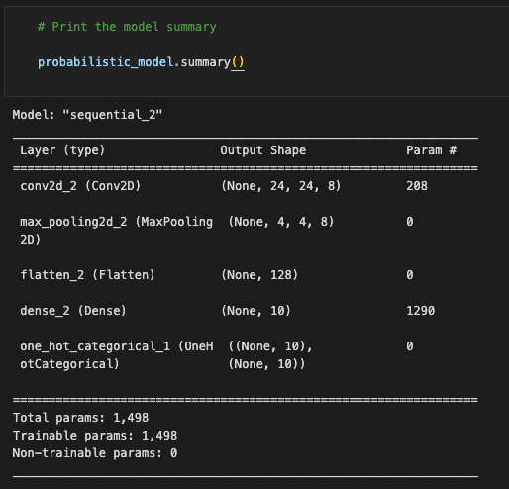
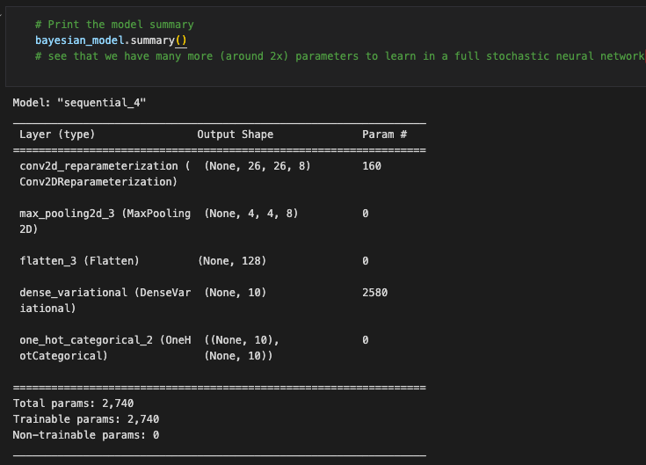
Notebook

Slide 66
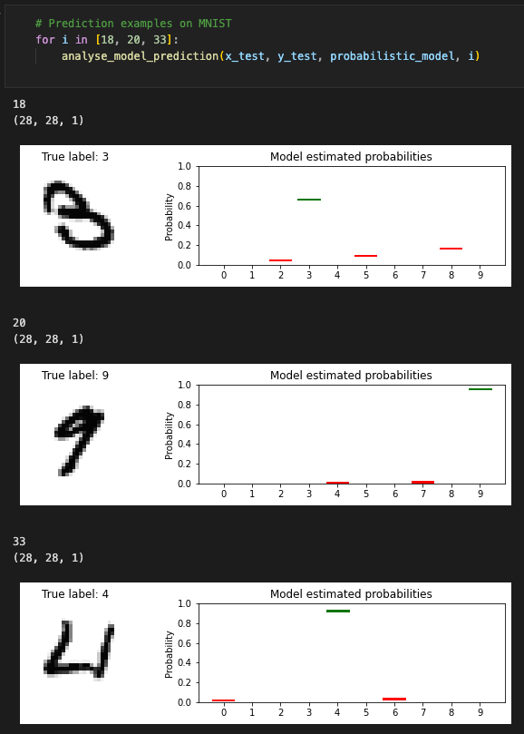
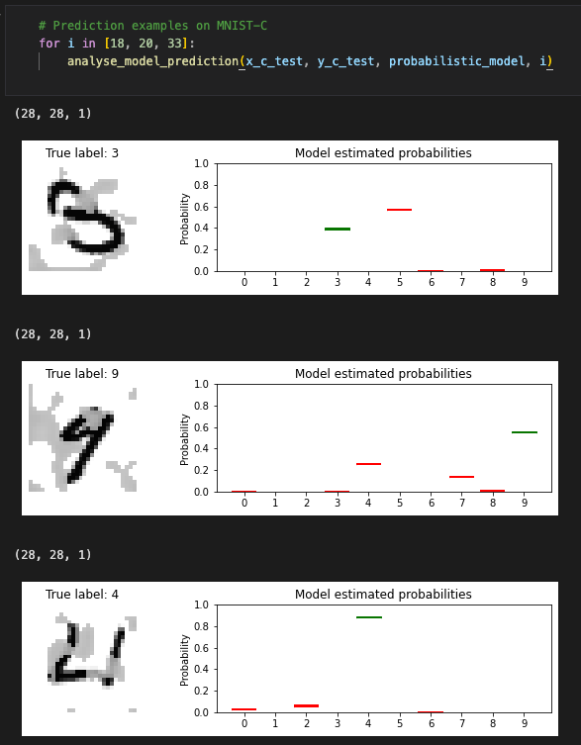




Notebook
$$p\left(w | D\right)=\frac{p\left(D | w\right)p(w)}{p(D)}$$
$$p\left(w | D\right)=\frac{p\left(D | w\right)p(w)}{p(D)}$$

Slide 67

Certain

Slide 68







References and learning material
Articles
Books
Online
https://www.coursera.org/
Blundell, Charles, Julien Cornebise, Koray Kavukcuoglu, and Daan Wierstra. "Weight uncertainty in neural network." In International conference on machine learning, pp. 1613-1622. PMLR, 2015.
Lawrence K Saul, Tommi Jaakkola, and Michael I Jordan. Mean field theory for sigmoid belief networks. Journal of artificial intelligence research, 4(1):61–76, 1996.
Radford M Neal and Geoffrey E Hinton. A view of the EM algorithm that justifies incremental, sparse, and other variants. In Learning in graphical models, pages 355– 368. Springer, 1998.
https://www.youtube.com/@MachineLearningSimulation
https://www.youtube.com/@KapilSachdeva
https://www.youtube.com/@veritasium

